Slide 1

Vibe Coding: Where AI Handles the Syntax, and You Build the Future
Niels Berglund
Software Architect Derivco
niels.it.berglund@gmail.com
https://nielsberglund.com
https://linkedin.com/in/nielsberglund

Slide 2


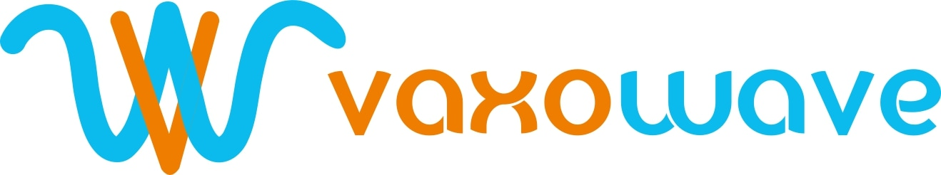



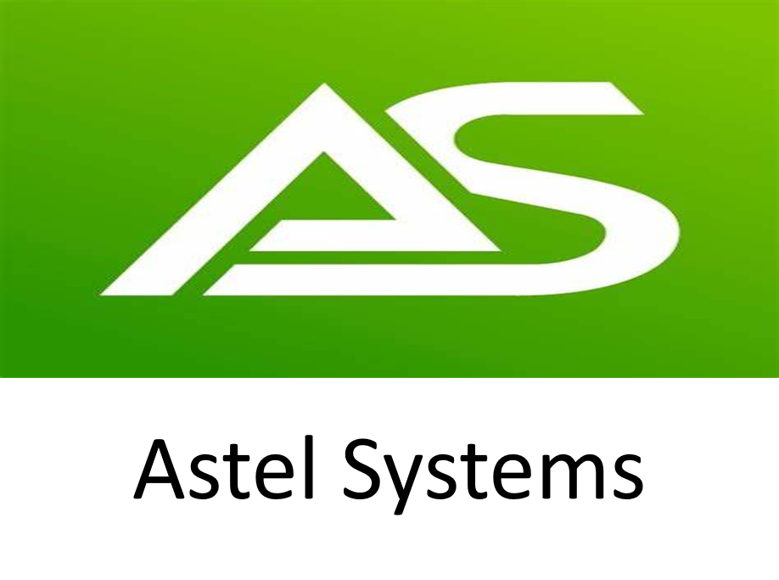
THANK YOU TO OUR SPONSORS
Platinum:
Gold:
Silver:

Slide 3

When I was Young …
In the beginning was:
Documentation, man pages, etc.
IntelliSense, code completion
It was smart
You had to know the API, syntax, etc.
Notes:
IntelliSense was a great step forward, but we still had to write the code
Reminisce briefly on how IntelliSense changed developer productivity.
Explain how we shifted from simple autocomplete to full-context generation.
Set up the transition to vibe coding: “What if the IDE understood what you wanted—and just built it for you?”

Slide 4

The Date
30 November 2022
Notes:
The world as we know it began on this date. What happened then?
ChatGPT was released, and the world became aware of GenAI.

Slide 5
The Rise of LLMs
LLMs learned how to write code:
Trained on billions of lines of code + documentation
Understand patterns, context, and intent
Can generate entire functions, APIs, full apps.
You no longer need to know how to do it - just what you want.
Notes:
We have come to the point where multiple LLMs can collaborate

Slide 6
What is Vibe Coding?
“I just see stuff, say stuff, run stuff, and copy paste stuff—and it mostly works.”
— Andrej Karpathy
Coding as a conversation
Use natural language to generate code
AI as your pair programmer
You focus on logic, UX, and vision – not syntax
Great for prototyping, throwaway projects, and solo builds
You don't read the code. You vibe with it!
Notes:
Andrey Karpathy: Director of AI at Tesla, co-founder of OpenAI
You are shifting from thinking about syntaxt, to think about systems.
You’re not typing less because you're lazy… you're typing less because you're vibing.
Going into demos

Slide 7
The Vibe Workflow
Step | You Do (Prompt) | AI Does (Generate)
1. Prompt | "Build a form with a dark mode toggle button" | Writes HTML/CSS/JS
2. Generate | Accept suggestion | Fills in logic, structure
3. Tweak | "Make button rounded" | Updates styles, layouts
3. Repeat | Paste error, ask for fix | Debugs and refines
Notes:
This is coding as a conversation
Show how AI turns devs into directors. The output is code, but the input is vibes.
Lead in to how so far you have written instructions, what if you can talk - SuperWhisper

Slide 8
Tools of the Trade
Github Copilot
VS Code
Cursor IDE / Replit / Claude / …
SuperWhisper
Your brain - Still essential (for now ☺)
Notes:
The tools are evolving, but the mindset is the real game-changer.
Are we still “coding” or “orchestrating”?
You’re a systems thinker, not a syntax wrangler
Codebases might outgrow your mental model—and that’s okay
The code grows beyond my usual comprehension... but it works

Slide 9
Takeaway Vibes
You are not writing less code - you are thinking at a higher level
AI handles the syntax
You handle the architecture, creativity and user experience
Vibe coding = faster iteration, fewer blockers, more fun
Build at the speed of thought!
Notes:
You just watched me build more in 20 minutes than I used to in a day. That’s the future

Slide 10

DON'T FORGET SESSION EVALUATION
Please evaluate the session!
Enter your name on the evaluation form to stand a chance to win awesome prizes!
URL: https://forms.office.com/r/AQeu9gpSGp

Slide 11

Thank You Questions?
Niels Berglund
niels.it.berglund@gmail.com
https://nielsberglund.com
https://linkedin.com/in/nielsberglund

